Slide 1
Speed Control of D.C. Motors

Slide 2

Factors Controlling Motor Speed
It has been shown earlier that the speed of a motor is given by the relation
where R_{a} = armature circuit resistance.
It is obvious that the speed can be controlled by varying (i) flux/pole, Φ (Flux Control) (ii) resistance R_{a} of armature circuit (Rheostatic Control) and (iii) applied voltage V (Voltage Control). These methods as applied to shunt, compound and series motors will be discussed below.

Slide 3
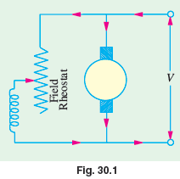
Speed Control of Shunt Motors
Variation of Flux or Flux Control Method
It is seen from above that N ∝ 1/Φ. By decreasing the flux, the speed can be increased and vice versa. Hence, the name flux or field control method. The flux of a d.c. motor can be changed by changing Ish with help of a shunt field rheostat (Fig. 30.1). Since I_{sh} is relatively small, shunt field rheostat has to carry only a small current, which means I²R loss is small, so that rheostat is small in size. This method is, therefore, very efficient.

Slide 4
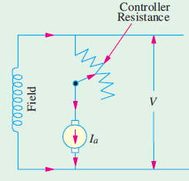
Speed Control of Shunt Motors
Armature or Rheostatic Control Method
This method is used when speeds below the no-load speed are required. As the supply voltage is normally constant, the voltage across the armature is varied by inserting a variable rheostat or resistance (called controller resistance) in series with the armature circuit as shown in Fig.
As controller resistance is increased, p.d. across the armature is decreased, thereby decreasing the armature speed.
For a load constant torque, speed is approximately proportional to the p.d. across the armature.

Slide 5
Speed Control of Series Motors
Flux Control Method
Variations in the flux of a series motor can be brought about in any one of the following ways :
Field Divertors
Armature Divertor
Trapped Field Control Field
Paralleling Field coils
Variable Resistance in Series with Motor
By increasing the resistance in series with the armature the voltage applied across the armature terminals can be decreased.
With reduced voltage across the armature, the speed is reduced. However, it will be noted that since full motor current passes through this resistance, there is a considerable loss of power in it.

Slide 6
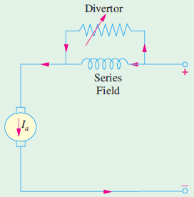
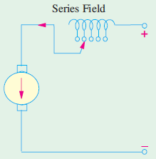
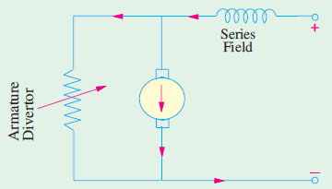
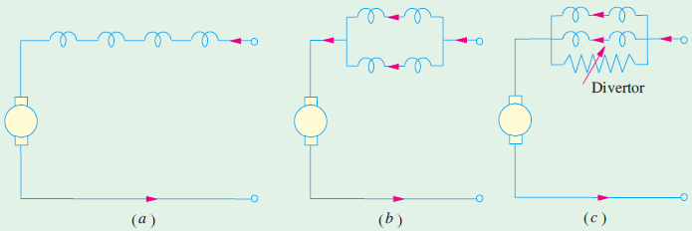
Speed Control of Series Motors

Slide 7
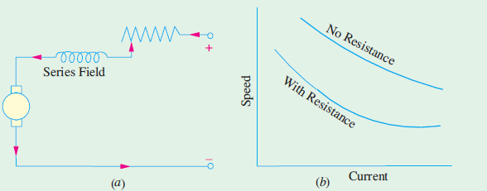
Speed Control of Series Motors

Slide 8
Merits and Demerits of Rheostatic Control Method
Speed changes with every change in load, because speed variations depend not only on controlling resistance but on load current also. This double dependence makes it impossible to keep the speed sensibly constant on rapidly changing loads.
A large amount of power is wasted in the controller resistance. Loss of power is directly proportional to the reduction in speed. Hence, efficiency is decreased.
Maximum power developed is diminished in the same ratio as speed.
It needs expensive arrangement for dissipation of heat produced in the controller resistance.
It gives speeds below the normal, not above it because armature voltage can be decreased (not increased) by the controller resistance.

Slide 9
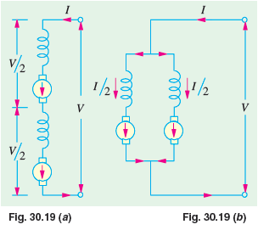
Series – Parallel Control
In this system of speed control, which is widely used in electric traction, two or more similar mechanically-coupled series motors are employed. At low speeds, the motors are joined in series Fig. 30.19 (a) and for high speeds, are joined in parallel Fig. 30.19 (b).

Slide 10
Necessity of a Starter
It has been shown in Art 29.3 that the current drawn by a motor armature is given by the relation
I_{a} = (V − E_{b})/R_{a}
where V is the supply voltage, E_{b} the back e.m.f. and R_{a} the armature resistance.
When the motor is at rest, there is, as yet, obviously no back e.m.f. developed in the armature. If, now, full supply voltage is applied across the stationary armature, it will draw a very large current because armature resitance is relatively small.

Slide 11
Shunt Motor Starter
The face-plate box type starters used for starting shunt and compound motors of ordinary industrial capacity are of two kinds known as three-point and four-point starters respectively.

Slide 12
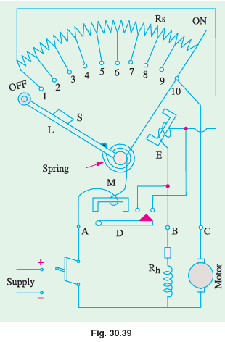
Three – Point Starter
The internal wiring for such a starter is shown in Fig. 30.39 . The three terminals of the starting box are marked A, B and C. One line is directly connected to one armature terminal and one field terminal which are tied together. The other line is connected to point A which is further connected to the starting arm L, through the overcurrent (or overload) release M.

Slide 13
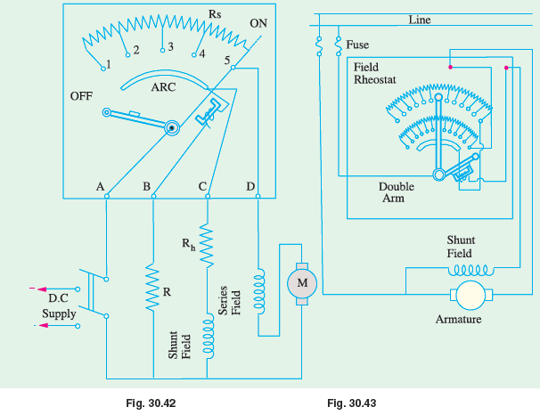
Four – Point Starter

